Slide 1
SHM
Instructor: Zonghua Gu

Slide 2
Claire Pagetti, Pierre Bieber, Julien Brunel, Kushal Gupta, Eric Noulard, Thierry Planche, Francois Vialard, Cl´ement Ketchedji, Bernard B´esinet, Philippe Despres, Reconfigurable IMA platform: from safety assessment to test scenarios on the SCARLETT demonstrator, ERTS 2012
Christian Engel, Eric Jenny, Peter H. Schmitt, Rodrigo Coutinhoz, Tobias Schoofs, Enhanced Dispatchability of Aircrafts using Multi-Static Configurations, ERTS 2010

Slide 3
Multi-static reconfiguration
a set of pre-qualified configurations from which the active one will be autonomously selected according to the system health state at system start-up.
Configuration selection mechanism based on a Byzantine Agreement algorithm

Slide 4
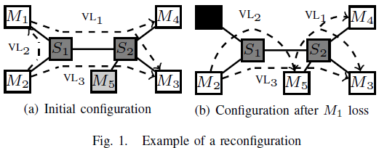
Reconfig Example
Module M5 is a spare initially shut down. If some failure occurs on moduleM1, the applications initially hosted on this module can be reconfigured on the spare M5 and all communications from and to M1 (VL1,VL2,VL3) must also be rerouted according to this new allocation.

Slide 5
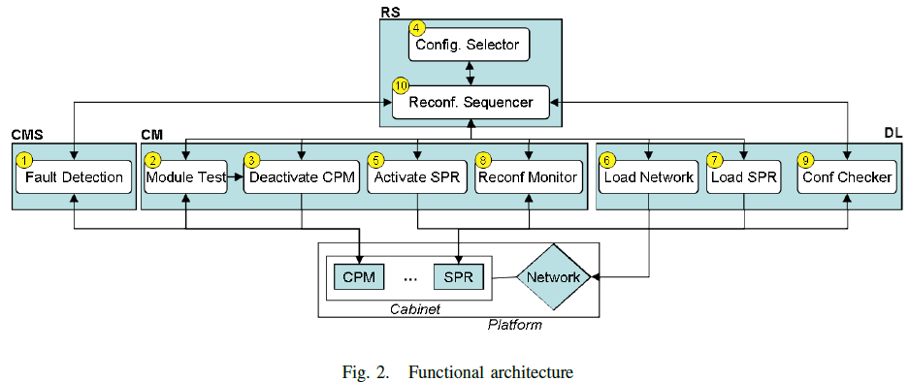
Reconfiguration Supervisor (RS) is the central entity that controls all reconfiguration activities.
Centralized Maintenance System (CMS) hosts the fault detection and diagnosis function which periodically checks all computing modules (CPMs) for their health and elaborates a consolidated diagnostic.
Cabinet Manager (CM) monitors the reconfiguration activities, shuts down the failed module and powers up a spare (SPR). A CM is associated with every cabinet (or cluster) where a cabinet consists of a switch and all the modules connected to the switch.
Data Loading and Configuration System (DLCS) comes into play at the end of the reconfiguration. Its main function is to load the spare with the application, to collect and control the loaded configuration.
Notes:
including selection of the spare module that replaces the faulty
Module
An alternative architecture for Reconfigurable IMA platform
was proposed in the DIANA project [EJS+10]. This architecture
shares the goals and assumptions of the SCARLETT
architecture. The goal is also to improve aircraft operational
reliability and it is assumed that the set of authorized configurations
is computed off-line. The DIANA architecture
is different because Fault detection, Fault diagnosis, Reconfiguration
Supervision and Data Loading are implemented
in a distributed way whereas they are implemented in a
centralized way in the SCARLETT architecture. In the DIANA
architecture, each module hosts a component that is able to
test the health status of its module and to exchange it with
other modules until a consensus is reached on the identity of
faulty modules. Then, based on the result of the consensus
protocol, the non-faulty modules select the new configuration
and they load the new applications. The authors claim that
the distributed implementation improves the availability and
integrity of reconfiguration mechanisms. In the SCARLETT
architecture, the loss of Centralized maintenance, Reconfiguration
Supervisor or Data Loading leads to the loss of reconfiguration.
This is not the case in the DIANA architecture. But
to achieve this improvement this architecture relies on a complex
and resource-consuming protocol between the modules
in order to reach a consensus. The SCARLETT architecture
brings a significant operational reliability improvement with
a simpler architecture that inter-operates with existing system
architectures for Maintenance and Data Loading.

Slide 6
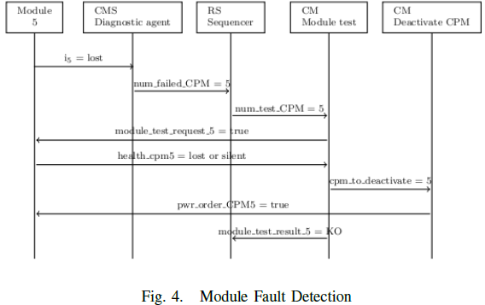
Module 5
The Module first sends its health status to the CMS, that informs the RS that module 5 is faulty.
The RS sends a request for fault confirmation to the function”Module Test” of the Cabinet Manager.
If the fault is confirmed then the Cabinet Manager will switch off the faulty module and inform the RS that module 5 is faulty and that reconfiguration should be performed
otherwise the Cabinet Manager informs the RS that no reconfiguration is needed.

Slide 7
DIANA Project

Slide 9
NASA

Slide 11
AUTOSAR specifies a Function Inhibition Manager (FIM), which can inhibit, based on certain events (e.g. errors), the execution of a function.

Slide 12
AUTOSAR Features for Functional Safety
Memory partitioning provides a fault containment technique to separate software applications from each other in order to avoid any data corruption between applications.
Defensive behavior is a solution preventing data corruption and wrong service calls in the AUTOSAR basic software on microcontrollers having no hardware support for memory partitioning.
Support for dual microcontroller architectures targets detection of faults in the core microcontroller by a secondary unit.
Program flow monitoring controls the temporal and logical behavior of applications by checking, at specified points of code execution, if the timing and logical order of execution requirements are met.
The end-to-end communication protection library is providing a state of the art safety protocol at application level to protect applications against the effects of faults within the communication link (e.g. random hardware faults or systematic faults within the software implementing the AUTOSAR communication infrastructure).
The AUTOSAR BSW provides modules to test hardware (e.g. RAM-Test, Core-Test) and to check the integrity of stored data (e.g. EEPROM Manager).
Notes:
This feature allows safety and non safety applications to be implemented on the same ECU.
In this way, the defensive behavior of basic software modules provides a low-cost efficient way to prevent fault propagation for applications with low and medium integrity levels.
Time determinism and timing constraints modeling allow modeling and implementing proper and deterministic timing behavior of applications and basic software. They include synchronized time bases (i.e. a "global time") across ECU networks, synchronized execution and deterministic timing of application software components, as well as support for controlling the timing behavior and detection of timing violations at run-time. The AUTOSAR specification of timing extensions provides means to specify timing constraints like end-to-end (e.g. sensor-to-actuator or communication) delays, minimum/maximum execution times of runnable entities, or constraints on the triggering rate of events.

Slide 13
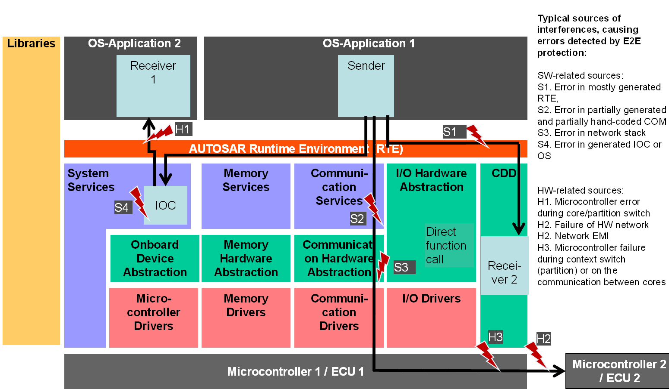
E2E Protection

Slide 14
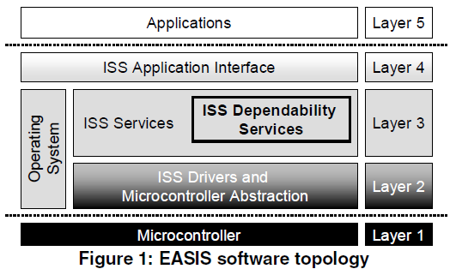

Slide 15
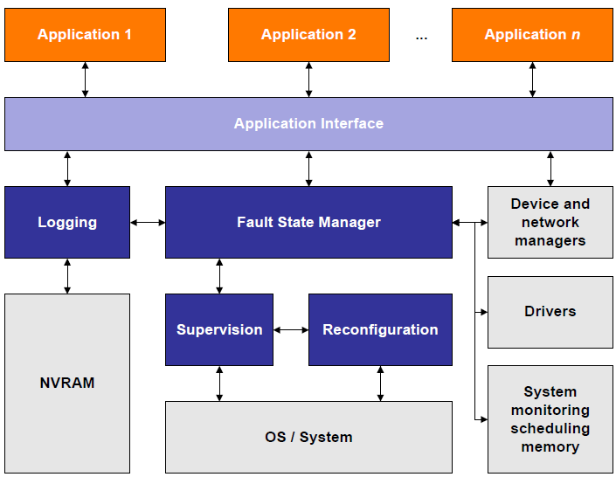

Slide 16
SWC1
SWC2
SWC3
AUTOSAR RTE
AUTOSAR OS (BSW)
Microcontroller Abstraction Layer
ECU HW Platform

Slide 17
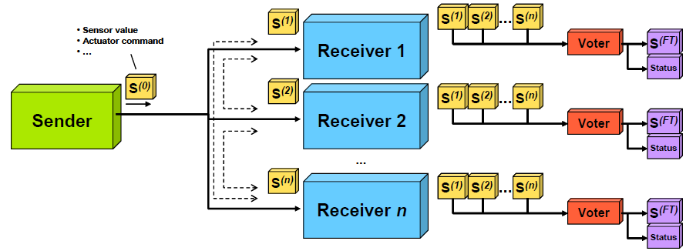
Agreement Protocol
Signed Message Protocol for handling Byzantine faults

Slide 18
Fault Management Framework
Main goals
To give a global view of the fault management issue
To ensure the consistency of the fault management strategies
To define central software artifacts for in-vehicle fault management and dependability
Focus of activities
Act upon error detection notification
Trace and identify faults
Tolerate faults
Other dependability activities
Notes:
.. Dependability and diagnosis services are part of a larger framework for on-board diagnosis
.. Fault management framework

Slide 19
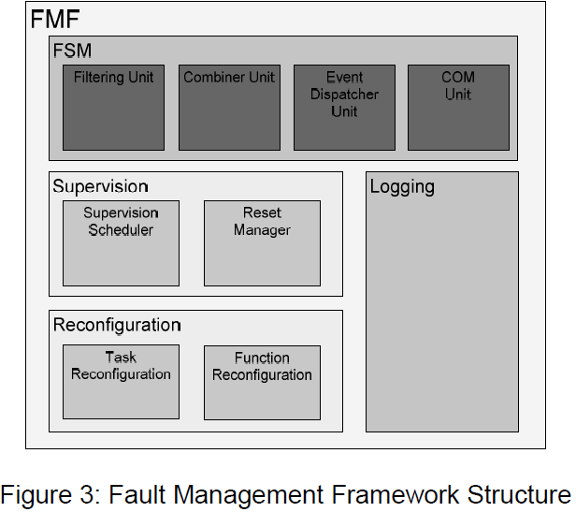
Fault Management Framework

Slide 20
Fault State Manager
Fault State Manager: the FSM is the core of the FMF since it receives the error reported from the software component and dispatches events to other units and software components. 4 sub-units
1. The filtering unit handles the filtering algorithms.
2. The combiner unit is responsible for updating the combined error.
3. The event dispatcher unit dispatches error events (i.e. change of error status) to event handlers.
4. The communication unit is responsible for distributing error information between the ECU local FMFs for a system wide fault treatment.

Slide 21
Supervision, Reconfiguration and Logging
Supervision Unit: decides which actions to perform next。 Implemented as a final state machine.
Reconfiguration Unit: provide mechanisms to reconfigure functions, runnables and tasks of the ECU. Functions can be activated or deactivated while tasks can additionally be restarted. Invoked by the Supervision Unit.
Logging Unit: the Logging Unit is responsible for managing the error history in non volatile memory, useful for later fault removal.
Notes:
(atomic code sequence of
applications)

Slide 22
SW Watchdog Functions
3 functions:
aliveness monitoring,
arrival rate monitoring
the program control flow checking
SW Watchdog informs Fault Management Framework, which can undertake different fault treatments depending on the source, type and severity of the detected faults.

Slide 23
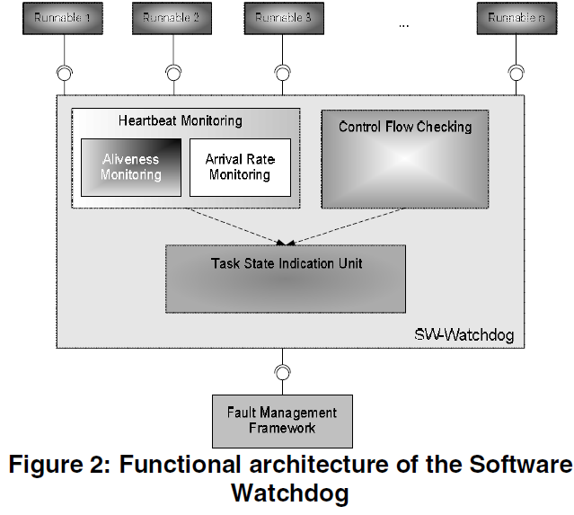
SW Watchdog
Heartbeat monitoring: record heartbeats from runnables
Control Flow Checking: monitors execution sequences of runnables
Task State Indication Unit: compares # detected errors to predefined thresholds
Notes:
other dependability software services in the EASIS software
topology, such as the
a general fault handling service in the platform, to

Slide 24
Heartbeat Monitoring
Heartbeats of each runnable in each monitoring period are saved in its Aliveness Counter (AC) and Arrival Rate Counter (ARC).
The monitoring periods are recorded in the Cycle Counter for Aliveness (CCA) and Cycle Counter for Arrival Rate (CCAR).

Slide 25
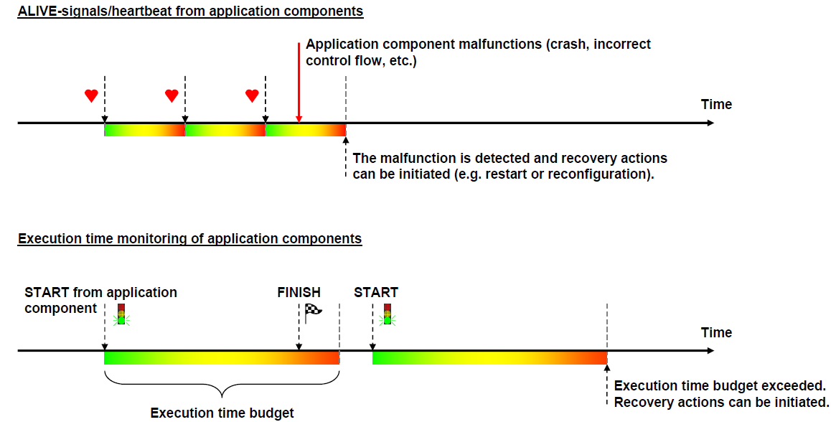
Heartbeat & Exec Time Monitoring

Slide 26
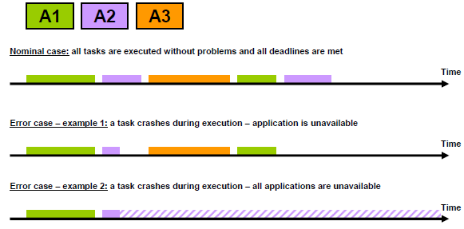
Task-Level Errors

Slide 27
Program Flow Checking
Detects runnable-level errors (within each task)
A look-up table stores all possible predecessor/successor relationships of the monitored runnables; They are compared to the actual execution sequence to detect control flow errors.
Other methods (not adopted) embedded signatures as proposed in [10], or with the watchdog processor as discussed in [13]
Notes:
[10] Nahmsuk Oh, P. Shirvani, E. McCluskey, "Control-
Flow Checking by Software Signatures," IEEE
Transaction on Reliability, vol. 51, Mar-2002, pp. 111-
121.
[13] T. Michel, et al., "A New Approach to Program Flow
Checking without Program Modification", Proc. 21st
Symposium on Fault-Tolerant Computing, pp. 334-341,
1991

Slide 28
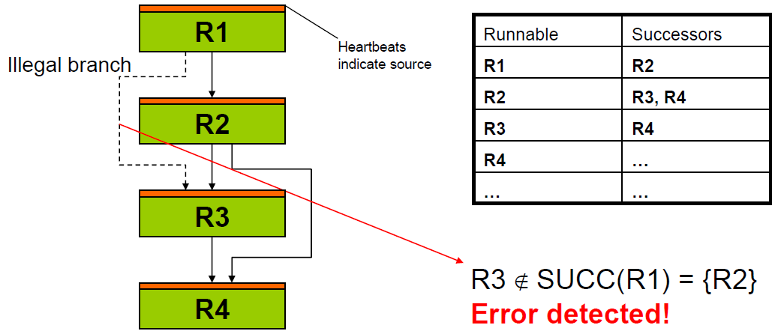
Program Flow Checking Example

Slide 29
Task State Indication
Task State Indication Unit keeps an error indication vector. If one of the elements in the error indication vector reaches the threshold, the whole task will be considered faulty.
If the global ECU state is “faulty”, the ECU might be subjected to a software reset depending on the requirements and constraints of applications.
If the global ECU state is “OK”, the “faulty” application software components might be restarted or terminated.

Slide 30
Fault Mitigation: Reconfiguration
Reconfiguration can be triggered by the FMF at 3 levels
Reconfiguration of active task set
Switch between predefined task sets
Functional inhibition
Passive w.r.t. platform→application receives info and has to act on this
ECU level reset
If all else fails →Ctrl-Alt-Del the ECU
Notes:
• Puts some constraints on mapping of runnables to tasks

Slide 31
EASIS Validator
A Hardware-in-the-Loop (HiL) system hosting a number of ISS-applications, such as the driver assistance applications, SafeLane and SafeSpeed.

Slide 32
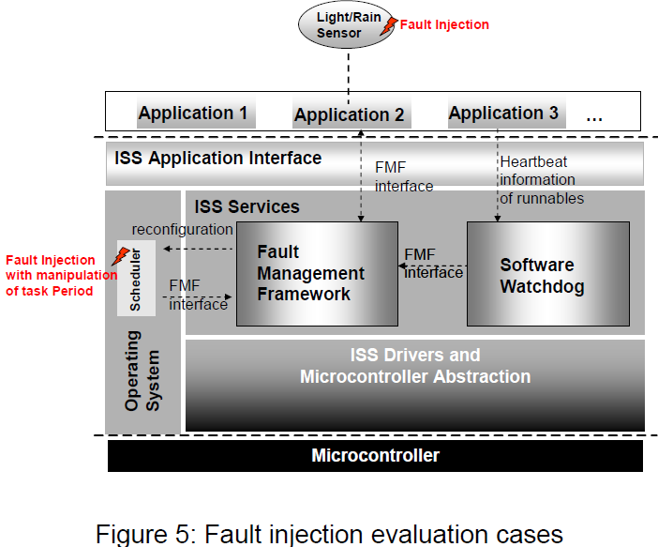
Fault Injection
Injection of sensor faults
Injection of task timing faults by changing task periods

Slide 33
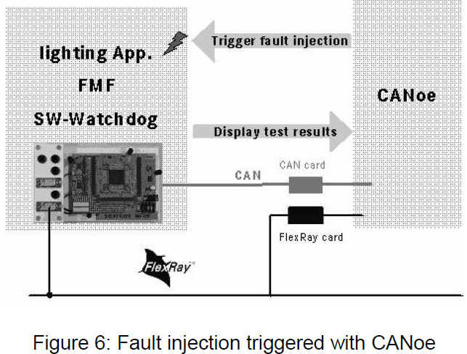

Slide 34
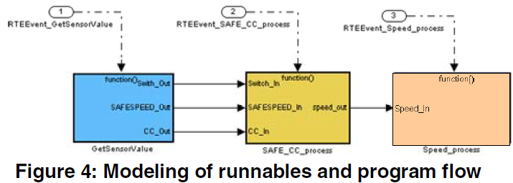
Application Example
The application has 3 runnables: GetSensorValue, SAFE_CC_process, Speed_process
These are triggered as function-call subsystems by the Stateflow chart SafeSpeed, which defines their execution sequence

Slide 35
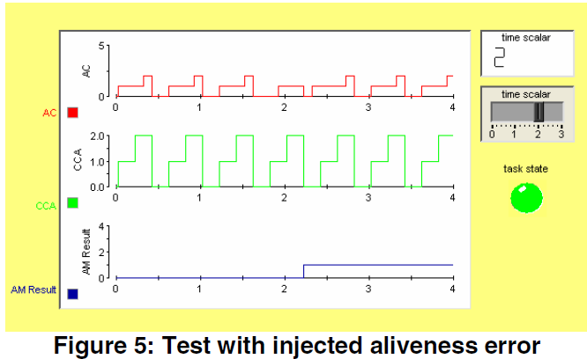
SW Watchdog
Aliveness Counter (AC) and Arrival Rate Counter (ARC).
AM Result” (Aliveness Monitoring Result) indicates the detection of the errors.
Notes:
3 functions: detection of the aliveness error, the arrival rate error and the program flow error

Slide 36
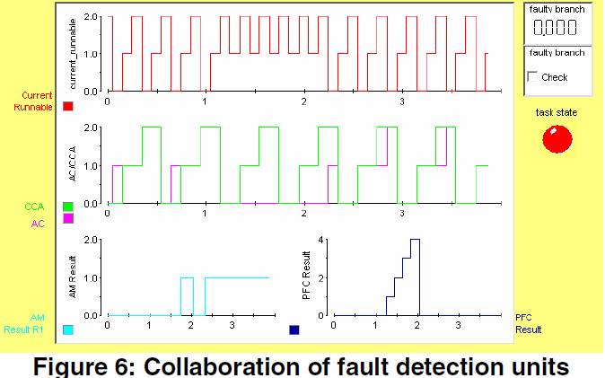
Fault Diagnosis
The aliveness errors detected by the heartbeat monitoring unit are actually caused by program flow errors, which are reported with the plot “PFC Result” (Program Flow Checking Result). After the detection of three program flow errors (which here is set as the threshold), the task state is set to “faulty”.

